Slide 1

Balancing Social Responsibility and Supply Chain Costs
Intro to Supply Chain Management
Group 9:
Junaid Jawad, Isaac Kakiko, Ashley Kankam, Smera Kapoor, Laney Keates

Slide 2
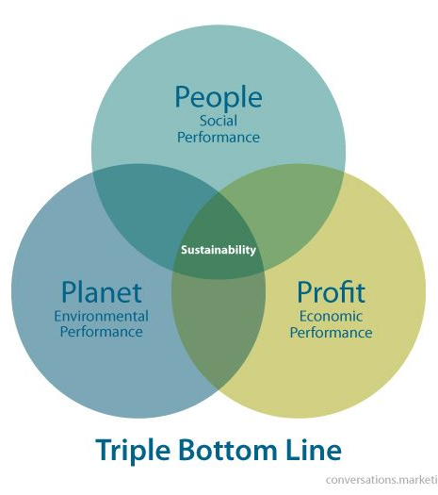
Social Responsibility in the Context of Supply Chains
Corporate Social Responsibility (CSR) = companies act ethically and contribute to society
Focuses on ethical behavior + social impact, not just profit
Applies to entire supply chain, not just the company
Ensures suppliers:
Treat workers fairly
Provide safe working conditions
Avoid child labor / unethical practices
Includes environmental responsibility:
Reduce waste
Use sustainable materials
Lower environmental impact

Slide 3
Socially responsible supply chain practices, such as fair wages & sustainability involve higher upfront costs.
1. Higher Sourcing Costs: Fair wages for workers; Sourcing sustainable/raw certified material
2. Higher Production Costs: Safer & healthier working conditions; Continuing to adopt sustainable practices; Remaining in compliance with environmental regulations
3. Higher Transportation/Logistics Costs: Eco-friendly shipping (low-emission shipping & electric/hybrid vehicles); Reduced packaging.
4. Higher Monitoring Costs: Supplier audits, warehouse management systems, real-time data monitoring, inventory analysis.
How Social Responsibility Impacts Supply Chain Costs.
Notes:
Short-Term Tradeoffs: Higher sourcing and operational costs; Reduced flexibility due to cost restraints.
Long-Term Benefits: Increased brand reputation and trust (90% of consumers more likely to support a company who has strong CSR measures); Risk mitigation & better compliance with regulations; Consumer demand for ethical products (80% would pay more for ethically-produced products); Sustainable initatives in the supply chain can reduce costs up to 16%.
Overall: Increases upfront supply chain costs but can create long-term financial and strategic advantages

Slide 4

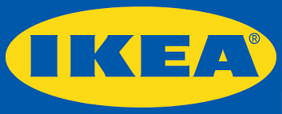
Practice: Committed to fair/living wages in their supply chain. IKEA works with suppliers worldwide to ensure living wages are paid, considering both local costs of living and family needs.
Cost Implications: Higher supplier and production costs; Monitoring, auditing, and compliance tracking expenses.
Benefits: Stronger brand reputation and trust. Stable supplier relationships leading to efficiency & fewer disruptions. Pay increases for more than 600,000 workers in IKEA’s supply chain, which promotes a more reliable supply chain, economic stability, and reduces poverty.
Costs of Ethical/Sustainable Practices in the Supply Chain
Practice: Have implemented a device recycling program that repairs, resells, and recycles customer’s old devices and used electronic network equipment.
Cost Implications: Incurs high reverse logistics & transport costs; handling, processing & refurbishment expenses.
Benefits: Reduced material costs through resource recovery from old phones (silver, gold, copper). Lowered environmental impact (reduced carbon emissions). Increased customer loyalty through trade-in programs & lower cost, high quality refurbished devices. Supports long-term supply chain sustainability.
Notes:
Vodafone has achieved their 2025 target of collecting 1 million used phones collected for refurbishment, reuse, recycling, or donation to social causes. Also achieved their goals of 100% of their decommissioned network equipment was reused, resold, or sent for recycling.

Slide 5
Frameworks for Balancing Cost and Responsibility
Triple Bottom Line (TBL)
People | Planet | Profit
The triple bottom line is a business concept that states firms should commit to measuring their social and environmental impact, n addition to their financial performance rather than solely focusing on generating profit, or the standard “bottom line.”
Circle Economy Framework
Reduced costs | Optimized resources | Supply chain resilience
The circular economy model emphasizes resource optimization and waste reduction by promoting continuous material reuse and recycling. It involves redesigning products for easy disassembly, using sustainable materials, and collaborating with suppliers committed to circular principles.
ESG Integration Strategy
Environmental | Social | Governance
Environmental: evaluates a company's carbon emissions, energy usage, and waste reduction efforts across the supply chain.
Social: assesses labor practices, worker safety, fair wages, and supplier working conditions.
Governance: examines transparency, ethical business conduct, and accountability in decision-making.
A supplier that scores poorly on ESG represents an ethical concern, financial, and reputational liability. By integrating ESG criteria into sourcing decisions, companies can balance cost efficiency with long-term responsibility
Total Cost of Ownership
True Cost | Risk | Responsibility
Evaluates the full cost of a sourcing decision, not just the initial purchase price, but every cost associated with a supplier or product over its entire lifecycle. TCO is directly relevant to social responsibility because what appears to be a low-cost supplier may carry significant hidden costs. A supplier offering lower wages or unsafe working conditions may seem cheaper upfront, but the risk of labor violations, public scandals, or regulatory penalties can far outweigh those savings.

Slide 6
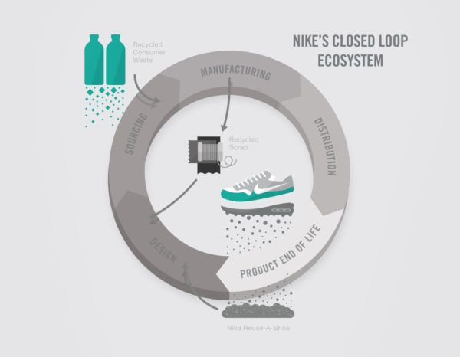
Balancing Social Responsibility and Cost: Nike
How Nike Balances CSR & Supply Chain Cost
Sustainable Sourcing → Cost Control
Uses recycled inputs (e.g., Fly Leather, scrap materials)
Reduces raw material procurement costs and dependency on new inputs
Lean Manufacturing & Waste Minimization
Reused 54M pounds of production scrap
Improves process efficiency and reduces manufacturing waste costs
Water & Resource Optimization
Reduced water usage by 43% in production
Implemented ColorDry (waterless dyeing technology)
Lowers utility costs and resource dependency
Supplier Monitoring & Compliance (SMSI)
Evaluates factories on ESG metrics (health, safety, environment)
Improves supplier reliability and reduces disruption risk
Closed-Loop Supply Chain (Circular Model)
Recycled materials back into production
Reduces inventory waste, disposal costs, and procurement needs
Impact
Improved operational efficiency across the value chain
Lower total cost of ownership (TCO)
Reduced supply chain risk and variability
Stronger supplier relationships and performance consistency
Notes:
• “The apparel industry creates about 10% of global carbon emissions, so Nike’s changes have a big impact at scale.”
• “Closed-loop systems also protect companies from future raw material shortages.”
• Water is outpacing population growth, and over the next decade, water demand will exceed the general population growth 4 to 1, implying two-thirds of the world’s population could be living in water-stressed areas [8]. The Color Dry investment marks Nike’s strong commitment to taking a future outlook and reducing its reliance on constrained resources

Slide 7
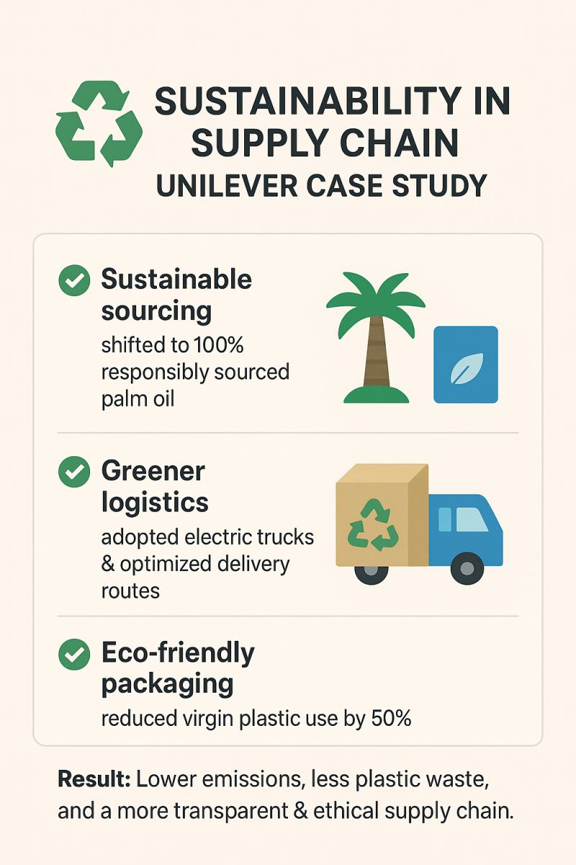
Balancing Social Responsibility and Cost: Unilever
Balancing Social Responsibility and Cost: Unilever
Triple Bottom Line Approach → People, Planet, Profit
People (Social Responsibility) → Supply Chain Ethics
Ensures fair labor practices and safe working conditions for suppliers
Improves livelihoods and strengthens supplier relationships
Reduces legal risks and supply chain disruptions
Planet (Environmental Responsibility) → Sustainability
Uses responsibly sourced materials like palm oil
Adopts greener logistics and reduces emissions
Minimizes plastic use and environmental impact
Profit (Cost Efficiency) → Business Performance
Reduces material, fuel, and operational costs through sustainability
Improves efficiency and resource utilization
Supports long-term profitability and supply chain stability
Impact
Balanced focus on people, planet, and profit
Lower total supply chain cost (TCO)
Reduced environmental footprint
More ethical and resilient supply chain
Notes:
By balancing people, planet, and profit, Unilever achieves lower total supply chain costs—also known as TCO (Total Cost of Ownership)—while reducing its carbon footprint and building a more ethical and resilient supply chain.
However, it’s important to note a key challenge:
Unilever has recently faced pressure from investors to improve financial performance, leading the company to scale back or delay some sustainability targets. This highlights a real-world challenge—balancing CSR with profitability is not always easy in practice.

Slide 8
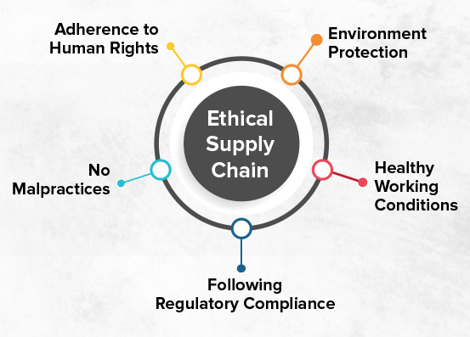
Strategies for Achieving Ethical and Cost-Efficient Supply Chains
Strategies:
Focus on nearshoring
  Decrease delivery charge
  Better quality product
  Takes away language barrier
Focus on Sustainability
  Using recycled materials would decrease cost.
  Improves the environment
Focus on Long-Term Supplier Relationships
  Possible discounts and lower prices
  Set working standards
  Easier to monitor progress

